Slide 1
Web programming
Prof. Yousef B. Mahdy
Faculty of Computers and Information Sciences
Assiut University

Slide 2
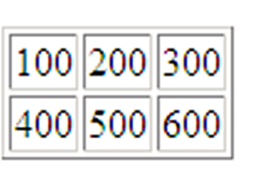
Tables
Used to create rows and columns of data

Slide 3
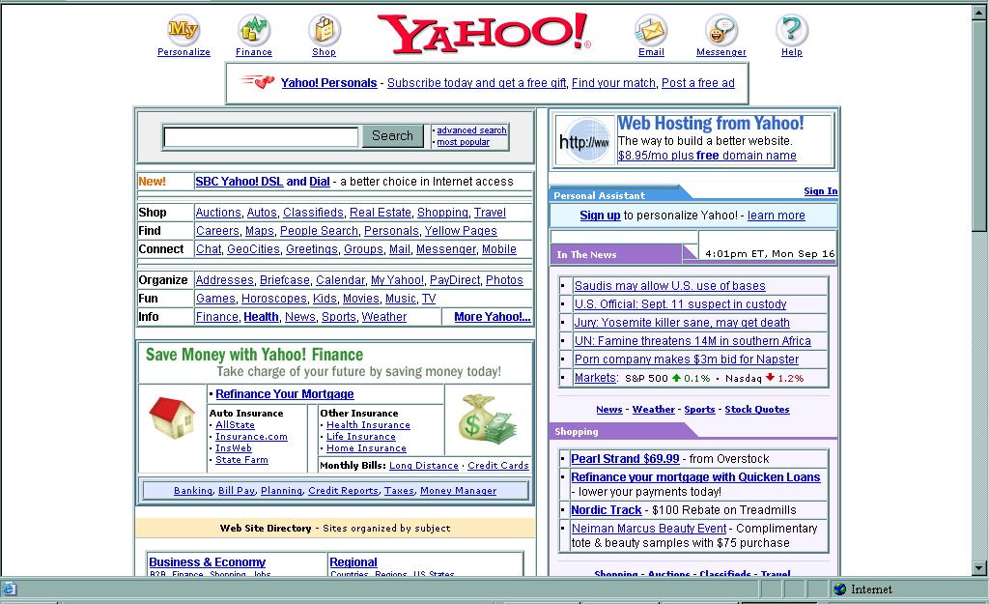
Tables
More importantly used to layout pages

Slide 4
Tags used in Tables
start by opening the table <table>
Then <tr> defines the beginning of a row
<td> defines beginning of a cell
insert the contents of the cell
</td>completes the cell
<td> next cell etc. </td>
</tr> to complete the row
<tr> define next row etc.
close the table when finished</table>

Slide 5
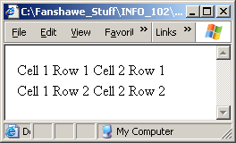
Example Table
<table>
<tr>
<td>Cell 1 Row 1</td>
<td>Cell 2 Row 1</td>
</tr>
<tr>
<td>Cell 1 Row 2</td>
<td>Cell 2 Row 2</td>
</tr>
</table>

Slide 6
Table Attributes
Adding a border to the table
  <table border=“1”>
Specifying table width
(measured in pixels or percent)
<table width=“75%”>
can also specify width of a table cell
<td width=“50%”>

Slide 7
Table Attributes
To add space in and around the cells:
  <table cellpadding=“7” cellspacing=“7”>
cellpadding is the space within the cell, surrounding the content (in pixels)
cellspacing is the space between the cells

Slide 8
Table Attributes
aligning the contents of cells
< td align=“right” valign=“top”>
where align will align the contents of the cells either left, right or center
valign will align the contents of the cell either top, middle or bottom

Slide 9
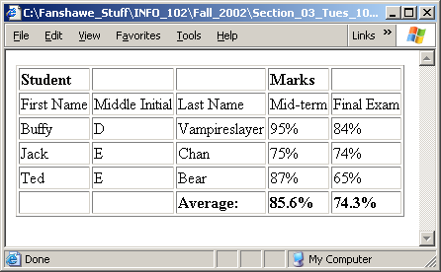
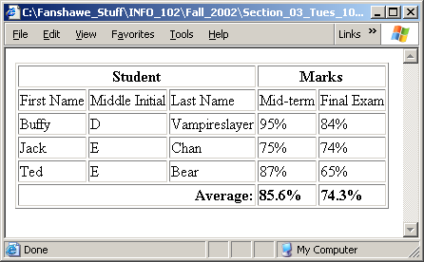
“Spanning” rows and columns
When you want to ‘combine’ or ‘merge’ columns or rows, you “Span” them:
These columns are ‘spanned’
These columns are ‘spanned’

Slide 10
Spanning” rows and columns
There are two types: “rowspan” and “colspan”
Rowspan goes in <tr>:
  <tr rowspan=“3” >
Colspan goes in <td>:
  <td colspan=“3” >

Slide 11
Tables
Tables are marked by the tags <TABLE> and </TABLE>. Inside these tags, you use table row tags, <TR> and </TR>, to define rows of data. Within each row, cells are defined by table data tags <TD> and </TD>. Code Example 12 presents a page containing a basic table.
Setting the BORDER attribute to 1 creates a 1-pixel-wide border around each cell as well as around the whole table. If you increase this value, the thickness of the table border increases, although the line around each cell remains 1 pixel wide.

Slide 12
Example 12
<HTML>
<HEAD>
<TITLE>Listing 3-1</TITLE>
</HEAD>
<BODY>
<TABLE BORDER="1">
<TR>
<TD>R1, D1</TD>
<TD>Row 1, Data 2</TD>
</TR>
<TR>
<TD>Row 2, Data 1</TD>
<TD>This is Row 2, Data Column 2</TD>
</TR>
</TABLE>
</BODY>
</HTML>

Slide 13
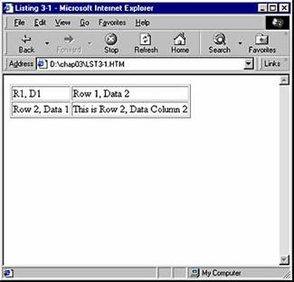

Slide 14
More Table Attributes
We set the BORDER attribute to 5 for the first table and 10 for the second; notice the difference in thickness of the outside border around each table .
The CELLPADDING attribute controls the amount of space between a cell's contents and the cell's boundary, whereas CELLSPACING controls the spacing between cells.
You can also change the background of an entire table, including the cells, by changing the setting of the BGCOLOR attribute, which controls the background color. By default, the background is transparent. If you set different background colors for a table and for a cell within that table, the cell's color takes precedence.

Slide 15
Example 13
<HTML>
<HEAD>
<TITLE>Listing 3-2</TITLE>
</HEAD>
<BODY>
<TABLE BORDER="5" CELLPADDING="2" CELLSPACING="15" BGCOLOR="yellow">
<TR>
<TD>R1,D1</TD>
<TD>Row 1, Data 2</TD>
</TR>
<TR>
<TD BGCOLOR="white">Row 2, Data 1</TD>
<TD BACKGROUND="back.gif">This is Row 2, Data Column 2</TD>
</TR>
</TABLE>
<HR>
<TABLE BORDER="10" CELLPADDING="15" CELLSPACING="2" BACKGROUND="back.gif">
<TR>
<TD>R1,D1</TD>
<TD>Row 1, Data 2</TD>
</TR>
<TR>
<TD BGCOLOR="white">Row 2, Data 1</TD>
<TD>This is Row 2, Data Column 2</TD>
</TR>
</TABLE>
</BODY>
</HTML>

Slide 17
More Table Attributes
The BACKGROUND attribute allows you to display an image behind a cell or an entire table; simply set this attribute to the path of the desired graphic. The last cell in the first table demonstrates a cell-only background, while the second table shows a full-table background image.
The BORDERCOLOR, BORDERCOLORLIGHT, and BORDERCOLORDARK attributes let you fine-tune the appearance of borders.
Attributes named FRAME and RULES control which sides of the outer and inner borders display.
You can also create table headers and footers using tags such as <THEAD> and <TFOOT>, and you can organize the information within tables using the <TBODY> tag.
The <CAPTION> tag can be used to label a table.

Slide 18
Cells of Variable Size
Not all cells in a table need to be the same size. For instance, some rows might require only two cells, while others need four. Some cells might need to be two or more rows tall.
To accommodate this variability, HTML provides the COLSPAN and ROWSPAN attributes. Code Example 14 offer an example of how you can use the COLSPAN attribute.
The COLSPAN attribute specifies the width of a cell in columns. A cell normally fills one column. Setting COLSPAN to 2 causes a cell to span two columns; setting it to 4 creates a cell width of four columns.

Slide 19
Example 14
<HTML>
<HEAD>
<TITLE>Listing 3-3</TITLE>
</HEAD>
<BODY>
<TABLE BORDER="1">
<TR>
<TD COLSPAN="2" ALIGN="center">Row 1, Data 1</TD>
</TR>
<TR>
<TD>Row 2, Data 1</TD>
<TD>Row 2, Data 2</TD>
</TR>
</TABLE>
</BODY>
</HTML>

Slide 20
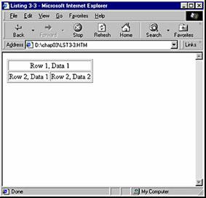

Slide 21
Example 15
Example 15, contains the sample code.
This example demonstrates two new techniques: the use of ROWSPAN and empty spacer cells. By setting the ROWSPAN attribute, you can create cells that are several rows tall, which is useful when you need to group types of data—in this case, apples and oranges.
You can also use ROWSPAN and COLSPAN together to create cells that are both extra wide and tall, though we do not demonstrate this in the sample.
Empty cells in the second row are denoted simply by a <TD> and </TD> tag pair, with nothing between the opening and closing tags. The Store 1 and Store 2 cells would have appeared at the far left of the row if we had not included these empty spacer cells.

Slide 22
Example 15
<HTML> <HEAD> <TITLE>Example 15</TITLE></HEAD><BODY><TABLE BORDER="1">
<TR>
<TD COLSPAN="4" ALIGN="center"><B>Fruit Sales</B></TD>
</TR>
<TR>
<TD></TD><TD></TD>
<TD>Store 1</TD><TD>Store 2</TD>
</TR>
<TR>
<TD ROWSPAN="2">Apples</TD>
<TD>Day1</TD><TD>40</TD><TD>25</TD>
</TR>
<TR>
<TD>Day2</TD><TD>30</TD><TD>30</TD>
</TR>
<TR>
<TD ROWSPAN="2">Oranges</TD>
<TD>Day1</TD><TD>40</TD><TD>25</TD>
</TR>
<TR>
<TD>Day2</TD><TD>30</TD><TD>30</TD>
</TR>
</TABLE>
</BODY>
</HTML>

Slide 23
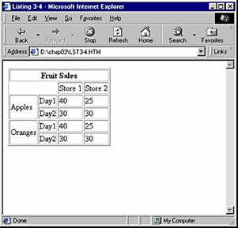

Slide 24
Embedded Tables
An embedded table is exactly what you might expect: one table contained within, or embedded in, another. This technique provides a wide range of flexibility, allowing you to assign different background and border treatments to various parts of the table, and is often easier to use than ROWSPAN and COLSPAN.
Code Example 16 demonstrates the embedding of two smaller tables within a larger table.
The code for the first cell also introduces a new attribute, VALIGN, which controls the vertical alignment of the contents of the cell. In this instance, we set VALIGN so that the cell contents appear at the top of the cell. In the fourth cell, we used both VALIGN and ALIGN to position the contents in the lower right corner of the cell.
Also notice that we used the BORDER attribute to vary the width of the border around each table.

Slide 25
Example 16
<HTML><HEAD><TITLE>Example 16</TITLE></HEAD><BODY>
<TABLE BORDER="1" CELLPADDING="5">
<TR>
<TD VALIGN="top">1</TD>
<TD>
<TABLE BORDER="2">
<TR><TD>A</TD><TD>B</TD></TR>
<TR><TD>C</TD><TD>D</TD></TR>
</TABLE>
</TD>
</TR>
<TR>
<TD>
<TABLE BORDER="5">
<TR><TD>E</TD><TD>F</TD></TR>
<TR><TD>G</TD><TD>H</TD></TR>
</TABLE>
</TD>
<TD VALIGN="bottom" ALIGN="right">2</TD>
</TR>
</TABLE>
</BODY>
</HTML>

Slide 26
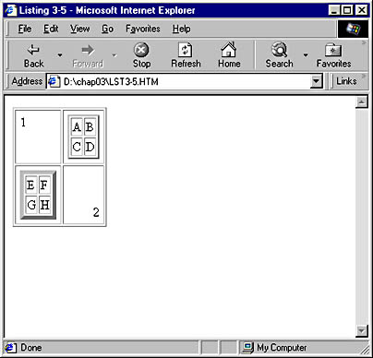

Slide 27
Tables as Layout Tools
Tables are perhaps the most important layout tool in conventional HTML. When you set the WIDTH and HEIGHT attributes for a table in combination with setting ALIGN and VALIGN attributes for cells, you can position items almost anywhere on a Web page.
The code shown in Code Example 17, for example, demonstrates how you can use a table to establish various regions on a page and specify that the regions contain different types of content. This example will dynamically resize as you resize your browser.

Slide 28
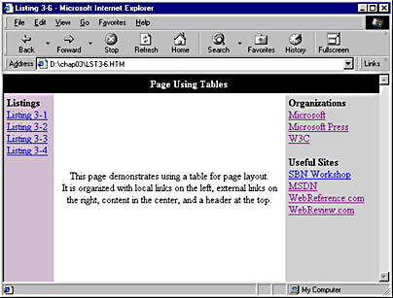
Example 17

Slide 29
<HTML>
<HEAD>
<TITLE>Listing 3-6</TITLE>
</HEAD>
<BODY TOPMARGIN="0" LEFTMARGIN="0">
<TABLE WIDTH="100%" HEIGHT="100%" CELLSPACING="0" CELLPADDING="5" BORDER="0">
<TR>
<TD COLSPAN="3" ALIGN="CENTER" BGCOLOR="black" HEIGHT="25">
<FONT COLOR="white"><B>Page Using Tables</B></FONT>
</TD>
</TR>
<TR>
<TD BGCOLOR="thistle" WIDTH="70" VALIGN="top">
<IMG SRC="trans.gif" WIDTH="70" HEIGHT="0" BORDER="0"><BR>
<B>Listings</B><BR>
<A HREF="lst3-1.htm">Listing 3-1</A><BR>
<A HREF="lst3-2.htm">Listing 3-2</A><BR>
<A HREF="lst3-3.htm">Listing 3-3</A><BR>
<A HREF="lst3-4.htm">Listing 3-4</A><BR>
</TD>
<TD ALIGN="center">

Slide 30
<IMG SRC="trans.gif" WIDTH="150" HEIGHT="0" BORDER="0"><BR>
This page demonstrates using a table for page layout.<BR>
It is organized with local links on the left, external links
on the right, content in the center, and a header at the top.
</TD>
<TD VALIGN="top" WIDTH="25%" BGCOLOR="lightgrey">
<IMG SRC="trans.gif" WIDTH="120" HEIGHT="1" BORDER="0"><BR>
<B>Organizations</B><BR>
<A HREF="http://www.microsoft.com">Microsoft</A><BR>
<A HREF="http://mspress.microsoft.com">Microsoft Press</A><BR>
<A HREF="http://www.w3.org">W3C</A><BR>
<BR>
<B>Useful Sites</B><BR>
<A HREF="http://microsoft.com/Workshop">SBN Workshop</A><BR>
<A HREF="http://msdn.microsoft.com/">MSDN</A><BR>
<A HREF="http://www.webreference.com">WebReference.com</A><BR>
<A HREF="http://www.webreview.com">WebReview.com</A><BR>
</TD>
</TR>
</TABLE>
</BODY>
</HTML>

Slide 31
Frames
By using frames, you can break up the Web page into distinct regions and show a different HTML file in each.
With this arrangement, one region can switch to another page while other regions remain the same. For instance, a page containing an advertising banner or a navigational menu (similar to a book's table of contents) can remain visible in one part of the browser window while the user jumps between pages in the site in another part of the window.
Frames can be a tremendously valuable layout tool, but they can also present a variety of problems.

Slide 32
Frame Basics
You create frames by using a frameset document, a standard HTML file that simply contains information about how the page should be split and which files should be displayed in each region.
Code Example 18 is the HTML code for a basic frameset document.
Notice that the document created in Code Example 18 does not include a body region. To avoid potential problems, HTML standards dictate that an HTML file can have either a frameset or a body but not both.

Slide 33
Example 18
<HTML>
<HEAD>
<TITLE>Example 18</TITLE>
</HEAD>
<FRAMESET COLS="50%,70,*">
<FRAME SRC="1.htm">
<FRAME SRC="2.htm">
<FRAME SRC="3.htm">
</FRAMESET>
</HTML>

Slide 34
Example 18:
The frameset in Code Example 18 points to three documents named 1.htm, 2.htm, and 3.htm.
Inside the <FRAMESET> tag, we included the COLS attribute, which indicates that the page will be divided into columns.
The attribute's three settings specify three columns: the first one will be 50 percent of the width of the browser window, the second will be 70 pixels wide, and the third will be allocated whatever space is left over (denoted by the asterisk symbol *).
If you set the size of frames using percentages, they will scale accordingly as the browser window is resized.
In the following Figure, notice the bars that separate the columns; a user can drag these bars to resize the columns.
Back in Code Example 18, notice that within the frameset lie the <FRAME> tags. These tags specify which HTML files the browser should display in each column of the frameset.

Slide 35
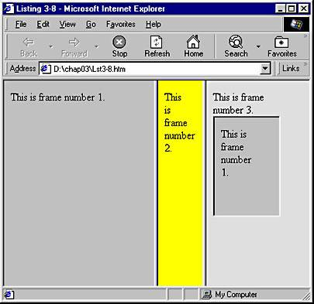

Slide 36
IFRAME
In accordance with the W3C's specifications, Internet Explorer supports a special type of frame called an in-line frame, or IFRAME. Unlike standard frames, which must be created using a frameset document, an IFRAME can be embedded in any standard Web page, just as an IMG or a TABLE can be.
Frame number 3 contains an IFRAME that displays the file 1.htm. You can see the IFRAME line in the code for the file 3.htm, shown below.
No current versions of Netscape Navigator support the IFRAME tag. They will simply ignore it.

Slide 37
IFRAME
<HTML>
<BODY BGCOLOR="blue">
This is frame number 3.
<BR>
<IFRAME SRC="1.htm" WIDTH="100">
</BODY>
</HTML>

Slide 38
Nesting
Like tables, framesets support embedding, or nesting, where one frame can be contained, or embedded, within another. With this feature, you can create a multitude of layouts.
Code Example 19 creates a more complicated frameset document by using nesting as well as a variety of attributes supported by framesets.

Slide 39
Example 19:
<HTML>
<HEAD>
<TITLE>Listing 3-9</TITLE>
</HEAD>
<FRAMESET ROWS="50,*" FRAMEBORDER="0" RAMESPACING="0">
<FRAME SRC="1.htm" NAME="frame1" SCROLLING="no">
<FRAMESET COLS="20%,80%" FRAMEBORDER="1" FRAMESPACING="1">
<FRAME SRC="2.htm" NAME="frame2" SCROLLING="yes">
<FRAME SRC="3.htm" NAME="frame3" SCROLLING="auto">
</FRAMESET>
</FRAMESET>
</HTML>

Slide 40
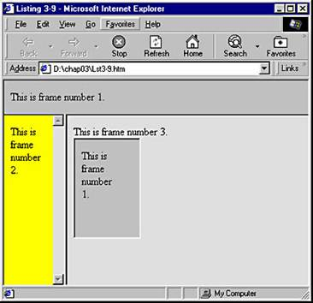

Slide 41
Code Example 19 creates a frameset that contains two rows. The first row is 50 pixels tall, and the second takes up the remainder of the screen. The first row consists of a frame that points to 1.htm. The second row contains a separate frameset, which in turn contains two columns of its own.
The FRAMEBORDER and FRAMESPACING attributes control the area between frames. If you want to prevent users from resizing frames, you can set both these attributes to 0, as we did for the outer frameset in Code Example 19.
Another way of creating nested framesets is to point the SRC attribute of a <FRAME> tag to another frameset document. We could have accomplished the same results as we did in Code Example 19 by replacing its inner <FRAMESET> tag with a <FRAME> tag that pointed to an HTML file containing the frameset it replaced.
The SCROLLING attribute determines whether and when scroll bars appear in a frame. A no setting prevents scroll bars from ever appearing. You should avoid using this setting unless you are sure that scroll bars will not be needed under any

Slide 42
Addressing Across Frames
The ability to address the contents of a frame from any other frame opens up a range of possibilities. Suppose you want to create a navigational toolbar. To make such a feature work, an anchor tag in the navigational frame must be able to address other frames in that frameset.
Code Example 20 creates a frameset with a simple navigation bar.

Slide 43
Example 20:
<HTML>
<HEAD>
<TITLE>Example 20</TITLE>
</HEAD>
<FRAMESET COLS="25%,75%" FRAMEBORDER="1" RAMESPACING="1">
<FRAME SRC="nav.htm" NAME="NavFrame" SCROLLING="yes">
<FRAME SRC="1.htm" NAME="ContentFrame" CROLLING="auto">
</FRAMESET>
</HTML>

Slide 44
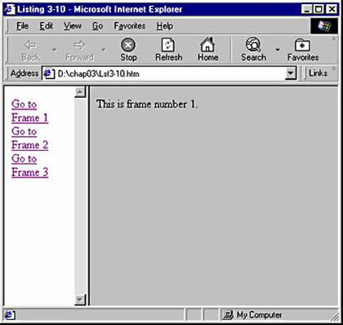

Slide 45
The frameset in Code Example 20 introduces a new HTML file named nav.htm, which contains this series of links:
<HTML>
<BODY>
<A HREF="1.htm" TARGET="ContentFrame">Go to Frame 1</A><BR>
<A HREF="2.htm" TARGET="ContentFrame">Go to Frame 2</A><BR>
<A HREF="3.htm" TARGET="ContentFrame">Go to Frame 3</A><BR>
</BODY>
</HTML>

Slide 46
Notice that each anchor tag contains a TARGET attribute. This attribute's setting tells the anchor which frame in the frameset should change when the anchor is clicked. In this case, when a user clicks one of the links, the contents of the frame named ContentFrame will change to 1.htm, 2.htm, or 3.htm.
You can set the TARGET attribute to a variety of special values (sometimes known as magic values), shown in the following list.

Slide 47
_blank: The named document is loaded in a blank, new window.
_self : The named document is loaded into the window that contains the link.
_parent: The named document is loaded into the parent of the window that contains the link. The parent of a frame is the document containing the frameset that called the frame.
_top : Any current frameset is discarded, and the named document is loaded into the full Internet Explorer frame.
For instance, if you want to use a link to exit your current frameset, you can use the setting _top, as shown in the following line of code:
<A HREF="1.htm" TARGET="_top">Exit Frameset</A><BR>
The file 1.htm would then fill the Internet Explorer window, replacing your frameset.
If you set the value of the TARGET to a name that does not exist in the current frameset (such as someotherframe, in our example), the browser will launch a new window that will have that name. All future links with that TARGET will change the contents of this new window.

Slide 48
Special Considerations
For each new frame in a document, Internet Explorer must download a new HTML file. This typically means a new connection with the server, which will slow down the load time of the overall page.
Because many older browsers do not support frames (though they are supported in versions 3 and later of both Internet Explorer and Netscape Navigator), you might want to consider using a <NOFRAMES> tag in your Web pages. Browsers that do not support frames will simply display any text you place between a <NOFRAMES> and </NOFRAMES> tag pair. This text can include anything from a pointer to a nonframes version of your site to a gentle suggestion that the user upgrade to a more recent browser.
All links leading to locations outside your site should have a TARGET attribute set to _top. Otherwise, users can find themselves trapped inside your frameset.

Slide 49
Forms
Forms allow interaction between a user and a server. The general concept is that the server displays a form to the user via a Web page, requesting any manner of information, such as name, address, phone number, age, and so on. The user then fills out the form and resubmits it to the server.
A form can contain a variety of elements, ranging from text entry fields to check boxes and drop-down lists.
Let's take a look at a basic form in Code Example 21.

Slide 50
Example 21:
<HTML>
<HEAD>
<TITLE>Listing 4-1</TITLE>
</HEAD>
<BODY>
<H1>This page contains a form.</H1>
<FORM NAME="F1" ACTION="http://ms.com/asp/prc.asp" METHOD="get">
<B>A text field follows.</B>
<INPUT TYPE="Text" NAME="txtFld" VALUE="A text field" SIZE="25">
<BR><INPUT TYPE="submit">
</FORM>
</BODY>
</HTML>

Slide 51
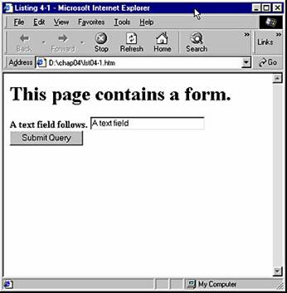

Slide 52
The Form Tag
The FORM element defines the extent of the form. All of the interactive parts of a form (text fields, select boxes, and so on) should be placed between the opening and closing <FORM> tags.
The <FORM> tag supports a number of attributes.
The <FORM> tag's NAME attribute gives the form a name. This makes it easier to access the data on the form and is especially useful when you have multiple forms on a page.
The ACTION attribute specifies the URL to which the form should deliver its information when a user clicks the Submit button.
In Code Example 21, the form will be processed by a file named prc.asp that resides in the asp directory on the Web site ms.com. This site does not actually exist, and thus the form will generate an error when submitted.
The type of file specified in the ACTION attribute depends on the type of server being run. Common Gateway Interface (CGI) applications are a common way of processing forms on most Web servers.
Microsoft Internet Information Server (IIS) supports Active Server Pages (ASPs), an easy and powerful method of processing forms.

Slide 53
Get method
The METHOD attribute specifies how the form should be submitted to the server. There are two standard options: get and post.
Get causes the form to act somewhat like an anchor tag. When submitted, the form will try to navigate to a location specified by the following, in the order shown:
the URL specified in the ACTION attribute a question mark
the contents of the form expressed in name=value pairs
This is simpler than it sounds. For example, if a form has an ACTION of http://www.ms.com/asp/prc.asp and has a text field with the NAME of UserFirstName in which a user has entered the text John, the form will try to link to the location

Slide 54
Get method
http://www.ms.com/asp/prc.asp?UserFirstName=John
The file prc.asp on the server will then take the text after the question mark (known as a query string) and process it as the contents of a form.
The entire address (including the question mark and any name=value pairs) will be visible in the address bar of the user's browser.
Some special characters might appear a bit strange in the address. For example, if you include an equal sign as part of a value, it appears as %3D. If the equal sign were transmitted as itself, it could be confused by the server as the equal sign in a name=value pair.

Slide 55
Post method
The post value for the METHOD attribute allows an unlimited amount of data to be sent to the server. If you do this sort of form submission, you will not see the form's information in the address bar.
Post is most useful with larger or more complex forms and with those in which you are trying to implement some level of security.

Slide 56
Which METHOD Should You Use?
Your choice of METHOD should be made based on several factors.
First, although forms-processing software on most servers can handle both get and post submissions, some are restricted to one or the other. In these cases, your decision is made for you.
The primary difference between the two methods is that get includes the form information as part of the URL in the address bar. This can be both an advantage and a disadvantage. A disadvantage is that many people find the form information ugly and distracting. Also, you might want to hide the form information from a user for security reasons. An advantage is that users can bookmark the results of the form submission because the bookmark is saved with the entire URL, including form contents. In addition, this information can give advanced users another method for navigating your site by keying in their own name=value pairs on the address line.
If you need to submit a significant quantity of information, post is probably the better choice because get can transfer only a limited amount of information. This limit is typically around 1000 characters, though it varies.

Slide 57
The Input Tag
As you'll see, the <INPUT> tag is very flexible and allows you to include different types of input ranging from check boxes to text entries in a form.
Code Example 22 illustrates all the various TYPE attributes of the <INPUT> tag.

Slide 58
Example 22:
<HTML>
<HEAD>
<TITLE>Listing 4-2</TITLE>
</HEAD>
<BODY>
<FORM NAME="F1" ACTION="http://ms.com/asp/prc.asp" METHOD="get">
<INPUT NAME="t1" TYPE="text" VALUE="This is a text input"><BR>
<INPUT NAME="p1" TYPE="password" VALUE="A password input"><BR>
<INPUT NAME="c1" TYPE="check box" VALUE="Check box 1">
This text is next to check box 1.<BR>
<INPUT NAME="c2" TYPE="check box" VALUE="Check box 2">
This text is next to check box 2.<BR>
<INPUT NAME="r1" TYPE="radio" VALUE="first radio ">
This text is next to the first radio button.<BR>
<INPUT NAME="r1" TYPE="radio" VALUE="second radio">
This text is next to the second radio button.<BR>
<INPUT NAME="b1" TYPE="button" VALUE="Just a button"><BR>
<INPUT NAME="f1" TYPE="file" VALUE="This is a file input."><BR>
<INPUT NAME="h1" TYPE="hidden" VALUE="A hidden input"><BR>
<INPUT NAME="rst" TYPE="reset" VALUE="A reset button"><BR>
<INPUT NAME="sbt" TYPE="submit" VALUE="A submit button"><BR>
<INPUT NAME="i1" TYPE="image" VALUE="An Image" SRC="a.gif"><BR>
</FORM>
</BODY>
</HTML>

Slide 59
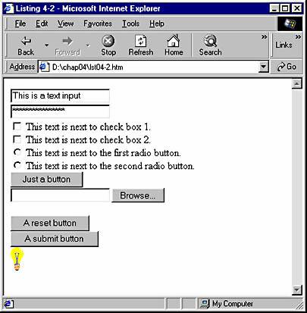

Slide 60
Every <INPUT> tag should contain a TYPE and a NAME attribute, and most will include a VALUE attribute. The TYPE attribute specifies what type of input will be requested from the user, such as a text box, check box, or radio button. The NAME attribute and the final contents of the VALUE attribute are sent to the server for processing when the form is submitted. Such information is known as a name=value pair. Other attributes vary with the input tag TYPEs, as you will see in the following paragraphs.
Setting a value of text for the TYPE attribute displays a single-line text entry field. This kind of field is useful for collecting such information as names and addresses from users. Input tags of TYPE text support a SIZE attribute, which specifies the visible width of the field. Additionally, you can use the MAXLENGTH attribute to establish the maximum number of characters allowed in the field and set the READONLY attribute to true to disable the field for user input.
The following tag would generate a text entry field 30 characters wide that would scroll as the user entered up to 100 characters.

Slide 61
<INPUT NAME="t1" TYPE="text" SIZE="30" MAXLENGTH="100">
Setting a value of password for the TYPE attribute displays a single-line text entry field in which asterisks appear instead of the actual characters typed by the user. Input tags of TYPE password support all the same attributes as those of TYPE text and behave identically, except in terms of character display.
Setting a value of check box for the TYPE attribute displays a standard check box. Adding the CHECKED attribute (just add the word CHECKED to the tag) results in a check box that is already checked. An input tag of TYPE check box is submitted with the form only if the check box is checked.

Slide 62
Setting a value of radio for the TYPE attribute displays a standard radio button. Adding the CHECKED attribute displays a radio button that is already selected. Typically, radio buttons are used to select one and only one choice from a number of alternatives.
Setting a value of button for the TYPE attribute displays a button. Whatever is specified in the VALUE attribute is used as the text of the button. Buttons can perform actions through script. Scripting will be covered in Part 2.
Setting a value of file for the TYPE attribute displays a text entry field and a Browse... button. This TYPE of input tag allows users to find and specify files on their machines. (This TYPE of input tag is not supported in Microsoft Internet Explorer version 3 unless the user has installed the file upload add-on.)
When the Browse... button is clicked, a standard Browse dialog box appears (the standard dialog box for the user's operating system) that lets the user graphically navigate the computer's file system. For security reasons, you cannot set a value for any input of TYPE browse.

Slide 63
Setting a value of hidden for the TYPE attribute results in an input that is not displayed. Hidden input tags are used to keep track of information that the user does not need to see.
Setting a value of reset for the TYPE attribute displays a Reset button. A Reset button will return the form to its default state, meaning all the input fields will return to the conditions they were in when the form was first downloaded.
Setting a value of submit for the TYPE attribute displays a Submit button. When this button is clicked, the form is submitted. As with the Reset button, if you specify a VALUE attribute, that text will be used for the text on the Submit button instead of the default, Submit Query.
An alternative to using a Submit button is to use the value image for the TYPE attribute. This value displays an image that acts just like the Submit button, in that when it is clicked, the form is submitted.
An <INPUT> tag that uses the image TYPE attribute supports two additional attributes: SRC and ALIGN. SRC defines the location of the image that should be displayed, and ALIGN specifies where the image should display relative to the text around it, just like the <IMG> tag.

Slide 64
The Text Area Tag
In addition to the <INPUT> tag, forms support a number of other interactive elements. The <TEXTAREA> tag allows for multi-line text input. Code Example 2 demonstrates the <TEXTAREA> tag.
<TEXTAREA> is similar to an <INPUT> of TYPE text in that it allows for text entry in a form. However, the <TEXTAREA> tag allows multiple lines of text to be entered. When the form is submitted, any text inside a TEXTAREA element is submitted as the value of the element. The text between the opening and closing tags of the element is displayed as the default text . This text and any changes made by the user are sent to the server for processing when the form is submitted.
You can set the size of the element with the COLS and ROWS attributes. COLS specifies the width of the TEXTAREA element in characters, while ROWS specifies the number of text lines a user can enter without needing to scroll. The WRAP attribute determines how the text wraps.

Slide 65
Example 23:
<HTML>
<HEAD>
<TITLE>Listing 4-3</TITLE>
</HEAD>
<BODY>
<FORM NAME="F1" ACTION="http://ms.com/asp/prc.asp" METHOD="GET">
<TEXTAREA NAME="TA1" COLS="40" ROWS="4" WRAP="soft">
This text is inside TEXTAREA 1. Note how lines of code are
automatically wrapped and how line breaks in the code cause breaks.
</TEXTAREA>
<BR>
<TEXTAREA NAME="TA2" COLS="40" ROWS="4" WRAP="off">
This text is inside TEXTAREA 2. Note how lines of code are
not automatically wrapped and how line breaks in the code cause breaks.
</TEXTAREA>
<BR><INPUT TYPE="submit">
</FORM>
</BODY>
</HTML>

Slide 66
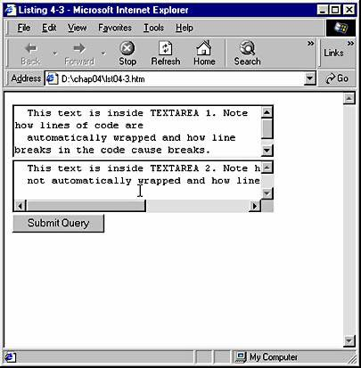

Slide 67
Select and Option Tags
The <SELECT> and <OPTION> tags allow for the creation of list boxes. Code Example 24 demonstrates three list boxes.
The <SELECT> tag supports two kinds of lists: standard (usually called drop-down) and multi-select.
The extent of the list is defined by the SELECT element. Inside the SELECT element reside OPTION elements, each representing an item in the list. A closing </OPTION> tag is not necessary.
The SELECT element supports a number of attributes. If you include the MULTIPLE attribute, the list box will allow multiple selections. With multi-select lists, users can press and hold the Ctrl key while they click each item they want; or they can click an item, press and hold the Shift key, and click a different item to select a range.
The SIZE attribute specifies the default number of rows that display. For standard lists, the default SIZE is 1, meaning only one line displays unless the user clicks the drop-down button, which then displays a scrollable list of items. If you set a standard list SIZE greater than 1, a scrolling list of options displays, from which one option can be selected. For multi-select lists, the default SIZE is 4. Changing this SIZE changes the number of items displayed.
Each OPTION element should have a VALUE attribute. When the form is submitted, the NAME

Slide 68
of the SELECT element is included with the VALUEs of the selected items in the list as the name=value pairs. If multiple OPTIONS have been selected, each selection is submitted as part of its own name=value pair. If you include the SELECTED attribute in an OPTION element, that OPTION element becomes the default selected item in the list. Descriptive text follows each of the OPTION elements. This text is what the user sees in the drop-down list.

Slide 69
<HTML><HEAD><TITLE>Listing 4-4</TITLE></HEAD>
<BODY>
<FORM NAME="F1" ACTION=http://ms.com/asp/prc.asp METHOD="get">
Select one item:
<SELECT NAME="sbt1">
<OPTION VALUE="option1">Text of option 1
<OPTION VALUE="option2" SELECTED>Text of option 2
<OPTION VALUE="option3">Text of option 3
<OPTION VALUE="option4">Text of option 4
<OPTION VALUE="option5">Text of option 5
</SELECT>
<HR>
Select one item:
<SELECT NAME="sbt2" SIZE="3">
<OPTION VALUE="option1">Text of option 1
<OPTION VALUE="option2" SELECTED>Text of option 2
<OPTION VALUE="option3">Text of option 3
<OPTION VALUE="option4">Text of option 4
<OPTION VALUE="option5">Text of option 5
</SELECT>
<HR>

Slide 70
Select multiple items:
<SELECT NAME="sbt3" MULTIPLE ALIGN="top">
<OPTION VALUE="option1">Text of option 1
<OPTION VALUE="option2" SELECTED>Text of option 2
<OPTION VALUE="option3">Text of option 3
<OPTION VALUE="option4">Text of option 4
<OPTION VALUE="option5">Text of option 5
</SELECT>
<BR><INPUT TYPE="submit">
</FORM>
</BODY>
</HTML>

Slide 71
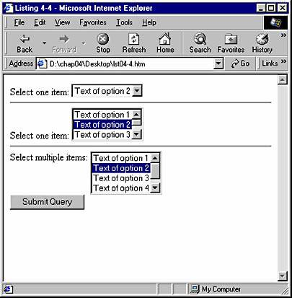

Slide 72
Introduction to Cascading Style Sheets
The Cascading Style Sheets (CSS) specification was developed by the World Wide Web Consortium (W3C) to head off this trend and to provide a simple model that separates the style of a document from the content.
A style sheet following this specification can be added to a Web page or site that specifies the appearance or style of all tags on the page or site.
CSS allows an unprecedented level of control over the appearance and layout of Web-based documents. With CSS, you can alter everything from the size, style, and color of text to the spacing between letters and lines, the border and padding around elements, and the exact position of an object on the page.

Slide 73
In-Line Styles
An in-line style is a style applied to a particular tag on a Web page. You can apply an in-line style to any tag on a page by using the STYLE attribute. Like other attributes, STYLE affects only the tag that contains it, just as setting the WIDTH attribute for an image affects only that image. Therefore, in-line styles are most useful for precise control of a single element, rather than for large-scale changes to an entire page or site.
The following listing uses the <SPAN> tag, which is especially handy when working with styles because it acts as a container for text without applying any formatting of its own. Thus, in the Web page created by the following code, the text between the opening <SPAN> tag and the closing </SPAN> tag will display like normal text, but it can be treated as one text chunk.

Slide 74
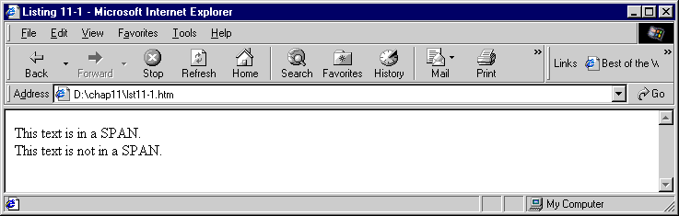
Example
<HTML>
<HEAD>
<TITLE>Listing 11-1</TITLE>
</HEAD>
<BODY>
<SPAN>This text is in a SPAN.</SPAN><BR>
This text is not in a SPAN.
</BODY>
</HTML>

Slide 75
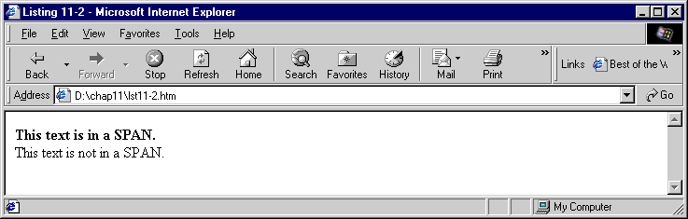
Example
<HTML>
<HEAD>
<TITLE>Listing 11-2</TITLE>
</HEAD>
<BODY>
<SPAN STYLE="font-weight: bold">
This text is in a SPAN.</SPAN><BR>
This text is not in a SPAN.
</BODY>
</HTML>

Slide 76
Style Sheets
A style sheet consists of one or more style definitions (also called style rules). A style sheet can be contained within a Web document or kept in a file outside the document. A style definition is made up of a selector followed by a declaration block, as shown in this example:
  SPAN {font-weight: bold; font-style: italic}
The selector is simply the item to which the style will apply. Selectors are designated by tag name only and omit the opening and closing angle brackets (< >) normally found in HTML.
The declaration block follows the selector and is enclosed in curly braces. This block is a list of style declarations, separated by semicolons. Our example contains two style declarations: font-weight: bold and font-style: italic.

Slide 77
Example
<HTML>
<HEAD>
<TITLE>Listing 11-6</TITLE>
<STYLE>
H1 {font-size: 16pt; font-weight: bold; color: red}
H2 {font-style: italic; font-size: 24pt; color: green}
SPAN {font-weight: bold; font-style: italic}
</STYLE>
</HEAD>
<BODY>
<SPAN>This text is in a SPAN.</SPAN>
<H1>This text is in an H1.</H1>
<H2>This text is in an H2.</H2>
</BODY>
</HTML>

Slide 78
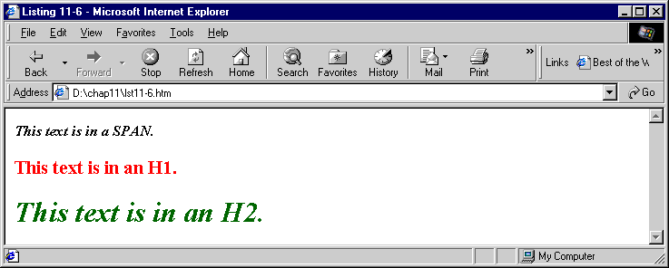

Slide 79
Linked Style Sheets
The formatting flexibility described in the preceding sections does not end at the level of the single Web page; you can control styles across several pages or even across an entire Web site by using linked style sheets.
A linked (or external) style sheet is simply a text file that includes style definitions; it is saved using the CSS filename extension. This file, which is external to the HTML file, can be referenced by (or linked to) an HTML document that uses the HTML <LINK> tag.
Let's demonstrate the use of a linked style sheet. First we need to set up the style sheet. To do this, we can use any text editor, such as the Notepad application, to create a file containing the style definitions shown in the following code:

Slide 80
H1 {font-size: 16pt; font-weight: bold; color: red}
H2 {font-style: italic; font-size: 24pt; color: green}
SPAN {font-weight: bold; font-style: italic}
We then save this file with the name styles.css. Notice that a linked style sheet does not include the <STYLE> and </STYLE> tags that are necessary with embedded style sheets in HTML documents.
We can now create an HTML document containing a link to this external style sheet. The code for this document appears in the following .

Slide 81
<HTML>
<HEAD>
<TITLE>Example</TITLE>
<LINK HREF="styles.css" REL="STYLESHEET" TYPE="text/css">
</HEAD>
<BODY>
<SPAN>This text is in a SPAN.</SPAN>
<H1>This text is in an H1.</H1>
<H2>This text is in an H2.</H2>
<H2 STYLE="font-size: 36pt">This is modified H2 text.</H2>
</BODY>
</HTML>

Slide 82
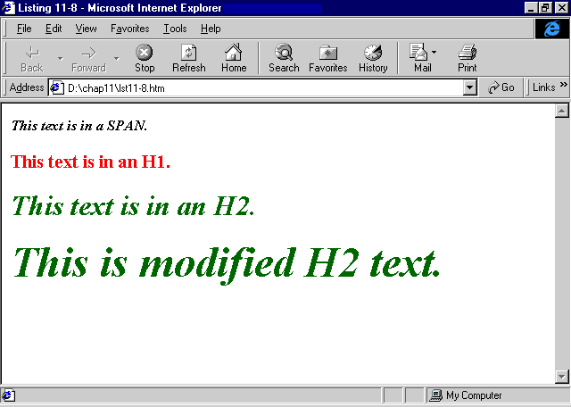

Slide 83
Classes
CSS supports the creation of classes. Put simply, a class is a variation of an existing element. For example, suppose you want to use the <B> tag throughout your document, but you want slight variations depending on where each tag is used.
As demonstrated in following code, you can create classes of B elements that have the style variations you want. B elements normally appear in boldface black type. A class simply adds its own formatting to the tag. Thus, in our example, every B element remains boldface, but the class modifies the font size of specific B elements.

Slide 84
Example :
<HTML>
<HEAD>
<TITLE>Example</TITLE>
<STYLE>
B.large {font-size: 24pt}
B.small {font-size: 8pt}
</STYLE>
</HEAD>
<BODY>
<B>This is a standard B.</B>
<B CLASS="small">This uses the small class.</B>
<B CLASS="large">This uses the large class.</B>
</BODY>
</HTML>

Slide 85
global class
You can create a global class that is usable by all elements if you do not specify a particular tag as a selector. Global classes are a powerful feature because they can be used for any tag on a page, as shown in the following code.

Slide 86
Example
<HTML>
<HEAD>
<TITLE>Example</TITLE>
<STYLE>
.large {font-size: 24pt}
.small {font-size: 8pt}
</STYLE>
</HEAD>
<BODY>
Standard text.
<H2 CLASS="small">The small class on an H2 element.</H2>
<SPAN CLASS="large">The large class on a SPAN element.</SPAN><BR>
<P CLASS="small">The small class on a P element.</P>
<B CLASS="large">The large class on a B element.</B><BR>
</BODY>
</HTML>

Slide 87
Links
Using dynamic styles, you can also change the style of the different states of a hypertext link, which is defined by the anchor tag, <A>. The anchor tag differs slightly from most other tags in that it has four states, called pseudoclasses. The four pseudoclasses are described here:

Slide 88
Pseudoclass State Default Appearance
Link The link has not been visited. Blue with underline
visited The link has been visited. Purple with underline
hover The mouse is resting over the link. Blue with underline
active The mouse is clicking the link. Blue with underline
All of these pseudoclasses are available in Internet Explorer. Only link and visited work inside current versions of Netscape Navigator.
When you create a style sheet, you can modify the style of a pseudoclass by separating the pseudoclass name from the anchor tag with a colon, as shown here:

Slide 89
A:link {color: yellow}
A:visited {color: red}
A:hover {color: green}
A:active {color: blue}

Slide 90
Example:
<HTML>
<HEAD>
<TITLE>Listing 11-13</TITLE>
<STYLE>
A:link {text-decoration: none}
A:hover {color: red; text-decoration: underline}
</STYLE>
</HEAD>
<BODY>
<A HREF="http://msdn.microsoft.com">msdn.microsoft.com</A><BR>
<A HREF="http://microsoft.com">microsoft.com</A><BR>
<A HREF="http://www.w3.org/style/">www.w3.org/style</A><BR>
<A HREF="http://www.w3.org">www.w3.org</A><BR>
</BODY>
</HTML>

Slide 91
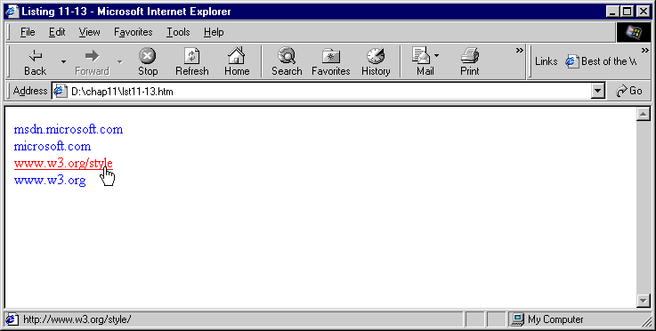

Slide 92
Dynamic Styles
In Internet Explorer, styles truly are dynamic in that they can be changed at any time. This is accomplished through scripting. The following Code presents a simple example of changing a style with in-line script.
<HTML>
<HEAD>
<TITLE>Listing 11-14</TITLE>
</HEAD>
<BODY>
<SPAN STYLE="color: red" onclick="this.style.color=`black'">
Click me!
</SPAN>
</BODY>
</HTML>

Slide 93
Fonts
<HTML>
<HEAD>
<TITLE>Listing 12-1</TITLE>
<STYLE>
SPAN {
font-family: "Arial Western", Verdana, sans-serif;
font-style: italic;
font-variant: small-caps;
font-weight: 700;
font-size: 18pt;
}
</STYLE>
</HEAD>
<BODY>
This sentence is standard text that has no custom style.
This sentence is also standard text that has no custom style.
<HR>
<SPAN>This text uses the custom SPAN style we created.</SPAN>
<HR>
As you can see, some parts of this paragraph <SPAN>use our
custom SPAN style,</SPAN> and some do not. This paragraph
demonstrates how the two types of text can interact and how
line spacing or wrapping can be affected by mixing styles.
</BODY>
</HTML>

Slide 94
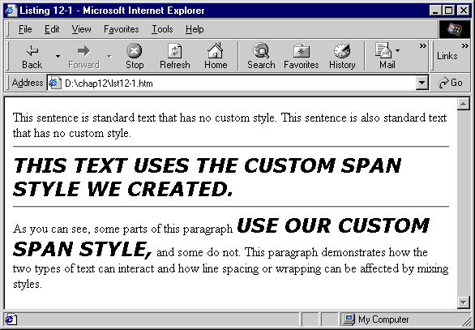

Slide 95
Text-Based Attributes
The attributes we have covered so far allow us to control the appearance of individual characters. Certain other CSS attributes allow you to change how groups of characters display. They include text-decoration, text-transform, text-align, text-indent, letter-spacing, and line-height. The color attribute is also commonly used with text.
The following Code demonstrates how these attributes work.

Slide 96
Example
<HTML>
<HEAD>
<TITLE>Listing 12-2</TITLE>
<STYLE>
DIV {
text-align: justify;
text-indent: 2em }
SPAN {
text-decoration: underline;
text-transform: uppercase;
vertical-align: super;
letter-spacing: .5em;
line-height: 200%;
color: red }
</STYLE>
</HEAD>
<BODY>
These first two sentences are just standard text that has no
custom style. We have created style rules for SPAN and DIV
elements.
<HR>
Some more standard text.
<SPAN>This text uses the custom SPAN style we created.</SPAN>
<HR>
More standard text.
<DIV>
This whole paragraph is inside a DIV element. <SPAN>This
sentence is in a SPAN, which is in the DIV.</SPAN> This
paragraph demonstrates that DIV is a block element and SPAN
is an in-line element. Notice how the styles interact.
</DIV>
</BODY>
</HTML>

Slide 97
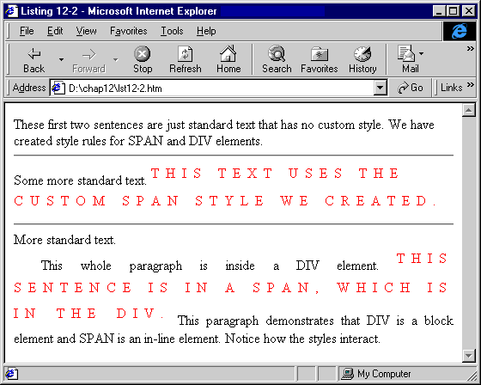

Slide 98
Font Embedding
The FONT element and the CSS font-family attribute allow you to specify a font to display, but they can specify only fonts the user already has. There is no guarantee that a person viewing the Web page has the desired font installed. Font embedding through the @font-face attribute lets you specify any font available to the designer and can practically guarantee that the user will have the font.
<HTML>
<HEAD>
<TITLE>Listing 12-3</TITLE>
<STYLE>
.crl {font-family: "Curlz MT"}
.viv {font-family: "Vivaldi"}
.stp {font-family: Stop}
DIV {font-size: 30pt}
</STYLE>
</HEAD>
<BODY>
<DIV CLASS="crl">This is some text using Curlz MT</DIV>
<DIV CLASS="viv">This is some text using Vivaldi</DIV>
<DIV CLASS="stp">This is some text using Stop</DIV>
</BODY>
</HTML>

Slide 99
Element Formatting
When planning the layout and formatting of an element, it is helpful to think of the element as surrounded by what are called formatting regions. Behind the element lies the background.
The padding separates the element from its border.
A margin lies around the border to separate this element from others.
The padding, the border, and the margin each have top, bottom, left, and right components.
Although not all of these formatting regions are relevant to every element, you will find many of them useful. The following illustration is a diagram of an element's formatting regions.

Slide 100
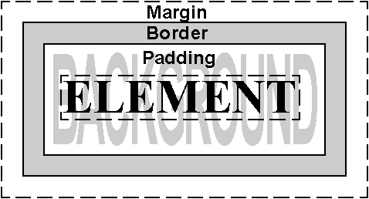

Slide 101
<HTML>
<HEAD>
<TITLE>Listing 13-4</TITLE>
<STYLE>
DIV {background-image: url(tile2.jpg); height: 75; width: 275;
border: solid 1px black; float: left; margin: 5px}
</STYLE>
</HEAD>
<BODY>
<DIV>
A global style sheet sets background-image, width, and height
for the DIV element. This uses the default background-position.
</DIV>
<DIV STYLE="background-position: bottom right">
This DIV has background-position set to bottom
right
</DIV>
<DIV STYLE="background-position: 25% 10px; background-repeat: no-repeat">
This DIV has background-position set to 25% 10px and
background-repeat set to no-repeat.
</DIV>
<DIV STYLE="background-position: center center">
This DIV has background-position set to center center.
</DIV>
</BODY>
</HTML>

Slide 102
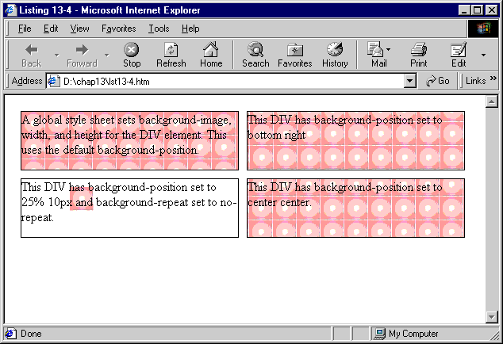

Slide 103
Example
<HTML>
<HEAD>
<TITLE>Listing 13-5</TITLE>
<STYLE>
DIV {border: groove red}
</STYLE>
</HEAD>
<BODY>
<DIV STYLE="border-width: thin">border-width of thin.</DIV>
<BR>
<DIV STYLE="border-width: medium">border-width of medium.</DIV>
<BR>
<DIV STYLE="border-width: thick">border-width of thick.</DIV>
<BR>
<DIV STYLE="border-width: 10px">border-width of 10px.</DIV>
<BR>
<DIV STYLE="border-width: 1em">border-width of 1em.</DIV>
</BODY>
</HTML>

Slide 104
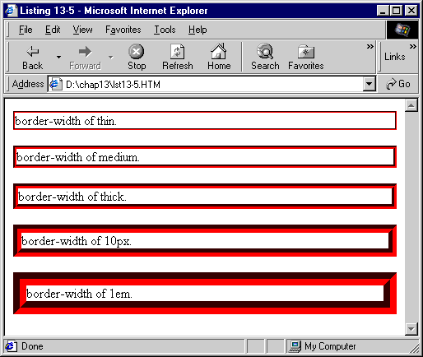

Slide 105
Controlling the Cursor with CSS
<HTML>
<HEAD>
<TITLE>Listing 14-3</TITLE>
</HEAD>
<BODY>
<TABLE BORDER="1" CELLSPACING="0" CELLPADDING="4">
<TR HEIGHT="50" VALIGN="TOP">
<TD STYLE="cursor:auto">auto</TD>
<TD STYLE="cursor:hand">hand</TD>
<TD STYLE="cursor:move">move</TD>
<TD STYLE="cursor:text">text</TD>
<TD STYLE="cursor:wait">wait</TD>
<TD STYLE="cursor:help">help</TD>
<TD STYLE="cursor:default">default</TD>
<TD STYLE="cursor:crosshair">crosshair</TD>
</TR>
</TABLE>
<BR>
<TABLE BORDER="1" CELLSPACING="0" CELLPADDING="4">
<TR HEIGHT="50" VALIGN="TOP">
<TD STYLE="cursor:w-resize">w-resize</TD>
<TD STYLE="cursor:nw-resize">nw-resize</TD>
<TD STYLE="cursor:n-resize">n-resize</TD>
<TD STYLE="cursor:ne-resize">ne-resize</TD>
<TD STYLE="cursor:e-resize">e-resize</TD>
<TD STYLE="cursor:se-resize">se-resize</TD>
<TD STYLE="cursor:s-resize">s-resize</TD>
<TD STYLE="cursor:sw-resize">sw-resize</TD>
</TR>
</TABLE>
</BODY>
</HTML>

Slide 106
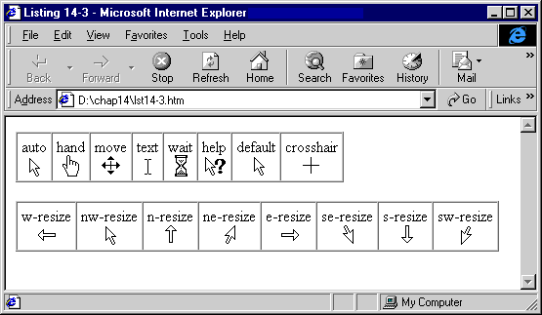

Slide 107
Controlling Lists with CSS
<HTML>
<HEAD>
<TITLE>Listing 14-6</TITLE>
</HEAD>
<BODY>
<UL>
The following LI tags have list-style-image specified.
<LI STYLE="list-style-image:url(one.gif)">url(one.gif)
<LI STYLE="list-style-image:url(img/two.gif)">url(img/two.gif)
<LI STYLE="list-style-image:url(img/three.gif)">url(img/three.gif)
<LI STYLE="list-style-image:none">none
</UL>
<HR>
<UL STYLE="list-style-position:outside">
<LI>This demonstrates how setting a list-style-position
of outside affects the way that text will wrap.
<LI>This demonstrates how setting a list-style-position
of outside affects the way that text will wrap.
</UL>
<UL STYLE="list-style-position:inside">
<LI>This demonstrates how setting a list-style-position
of inside affects the way that text will wrap.
<LI>This demonstrates how setting a list-style-position
of inside affects the way that text will wrap.
</UL>
</BODY>
</HTML>

Slide 108
